Slide 1



Slide 2

Forecast & Outlook
Image Source: Shutterstock
© 2025 Technomic, Inc. | Foodservice Planning Program

Slide 3
Reaching the Operator
Retention & Development
of Loyalty
Awareness
Consideration
IDEAS COME FROM
Word of mouth
Following other restaurants/chefs
Food shows (local)
Social media sites (distributor, publications, manufacturer, trade associations)
General internet search
However, times are changing. Younger buyers rely more on social media and general internet searches for inspiration
And while most generations are looking for recipe ideas, ideas that solve operational challenges will earn the attention of Gen Z

Slide 4
Reaching the Operator
Retention & Development
of Loyalty
Awareness
Consideration
IDEAS COME FROM
Word of mouth
Following other restaurants/chefs
Food shows (local)
Social media sites (of distributors, publications, manufacturers, trade associations, etc.)
General internet search
INFORMATION COMES FROM
Distributor website (tied for first)
Distributor sales representative (tied for first)
General internet search
Manufacturer website
Once again, there is a shift toward general internet searches and less reliance on the DSR among younger operators

Slide 5
Reaching the Operator
Retention & Development
of Loyalty
Awareness
Consideration
IDEAS COME FROM
Word of mouth
Following other restaurants/chefs
Food shows (local)
Social media sites (of distributors, publications, manufacturers, trade associations, etc.)
General internet search
INFORMATION COMES FROM
Distributor website (tied for first)
Distributor sales representative (tied for first)
General internet search
Manufacturer website
LOYALTY IS CREATED BY
Maintaining high levels of service/consistent supply
Demonstrating value (deters price shopping)
Maintaining product performance and quality
After above needs are met, consider promotional/merchandising material and traditional loyalty programs

Slide 6
THE FUTURE OF ON-PREMISE AND OFF-PREMISE
“In-unit” is business focus but off-premise is growth engine
SUPPLIER ACTIVATION
Prioritize versatility to meet operator omnichannel requirements
Notes:
Focus on dine-in applications but assume items will travel
Optimize product portfolio for omnichannel reality
Support effective menu item presentations across order platforms

Slide 7

Delivery occasions narrowing
Uptick in
Solo orders
To satisfy cravings
Snacks/off-peak dayparts
Third-party ordering
Supplier Activation
Lean into craveability, shareables and bundles, varied daypart applications
Notes:
Delivery smallest share of consumer occasions, operator sales – very distinct occasion and becoming more so

Slide 8
THE FUTURE OF ON-PREMISE AND OFF-PREMISE
Operators are enhancing service formats, extending concepts
SUPPLIER ACTIVATION
Step up with menu item engineering, packaging, menuing expertise
Fill operator data/ insights gaps, particularly about delivery

Slide 9
DAYPART DYNAMICS
Consumers’ busy lifestyles, flexible schedules disrupting the traditional mealtime boundaries
SUPPLIER ACTIVATION
Promote versatile, multiple-daypart products
Notes:
Implication: Promote versatile products that can be used any time throughout the day. Provide culinary support to help operators meet customers “where” they are – that can be physically (on /off premise) or mentally (in a hurry), and in some cases, financially, depending on your segment). Support operators to develop optimal menus of which core items can be provided all day, offer various portions that can meet a heavier lunch or a snackable / grazing occasion, and always keep in mind that the items have to hold up for off premise & car eating.

Slide 10
DAYPART DYNAMICS
Consumer need to connect at dinner will remain strong, especially while relaxing at home
SUPPLIER ACTIVATION
Support experiential occasions both on- and off-premise

Slide 11
2025: Expect to See a Better Year

Slide 12
Foodservice industry Growth
Notes:
We are expecting a less optimistic year for foodservice on the real front
Take out inflation

Slide 13
Segment outlook

Slide 14
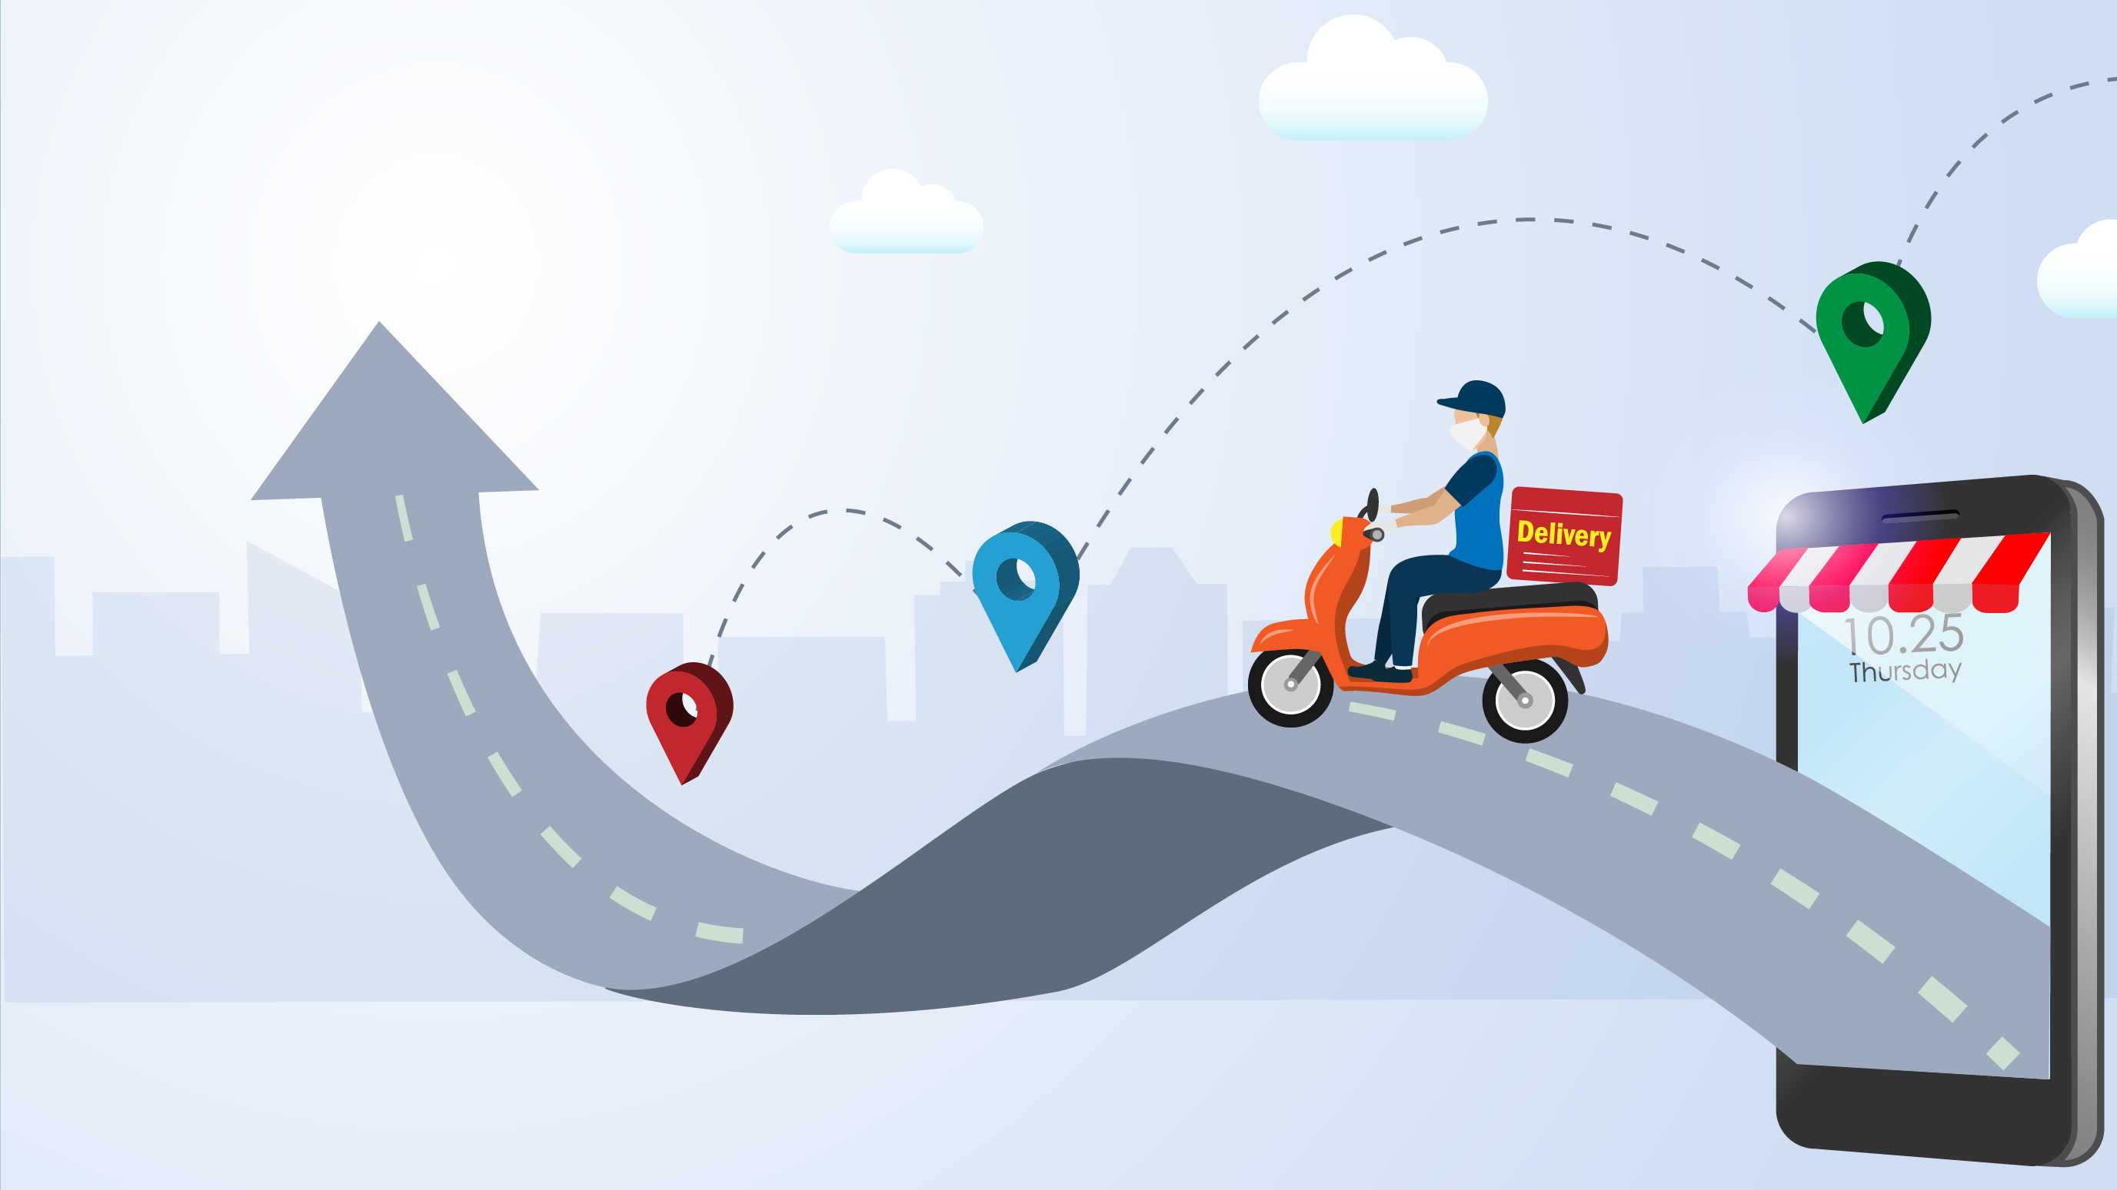
Sustained growth to return in 2025
More dealing
Moderating inflation
More confident consumer
Industry hits $1 trillion in sales without alcohol
50/50 foodservice-retail consumer dollar split
© 2025 Technomic, Inc. | Foodservice Planning Program

Slide 15

Restaurants fare better
FSR independent and chain turnaround
Net positive unit change
Revitalization
© 2025 Technomic, Inc. | Foodservice Planning Program

Slide 16
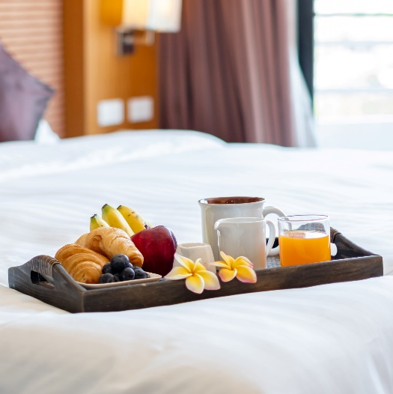
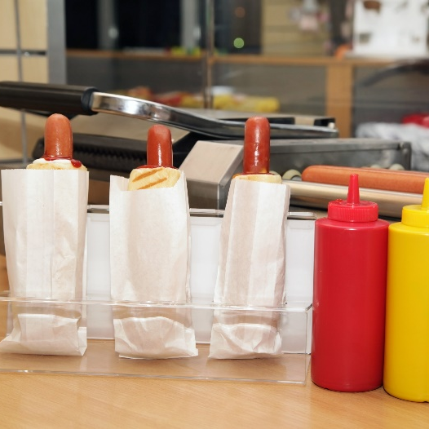
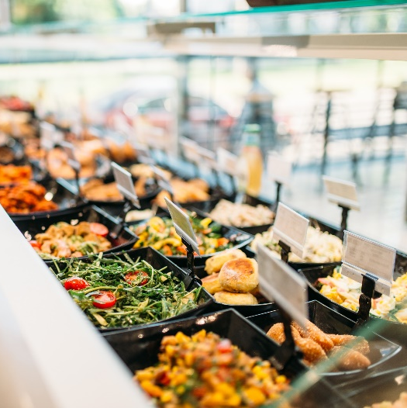

Other segment highlights
Lodging
Services reopening but not to full capacity
Slowing occupancy
C-Store Foodservice
Prime players expand
Supermarket Foodservice
Solid value option
Senior Living
Aging population
Some pent-up demand
Foodservice a differentiator

Slide 17


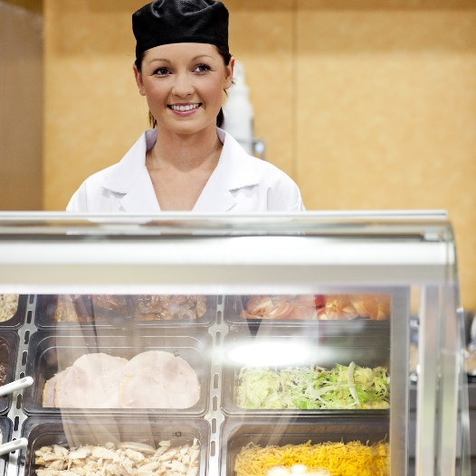

Other segment highlights
Business & Industry
Hybrid is here to stay
Colleges & Universities
Enrollment is up
K-12
Slowing/declining enrollment on the horizon
Refreshment Services
Micromarkets replacing cafeterias in white-collar workplaces

Slide 18

“The best vision is insight”
—Malcolm Forbes
© 2025 Technomic, Inc. | Foodservice Planning Program

